Slide 1
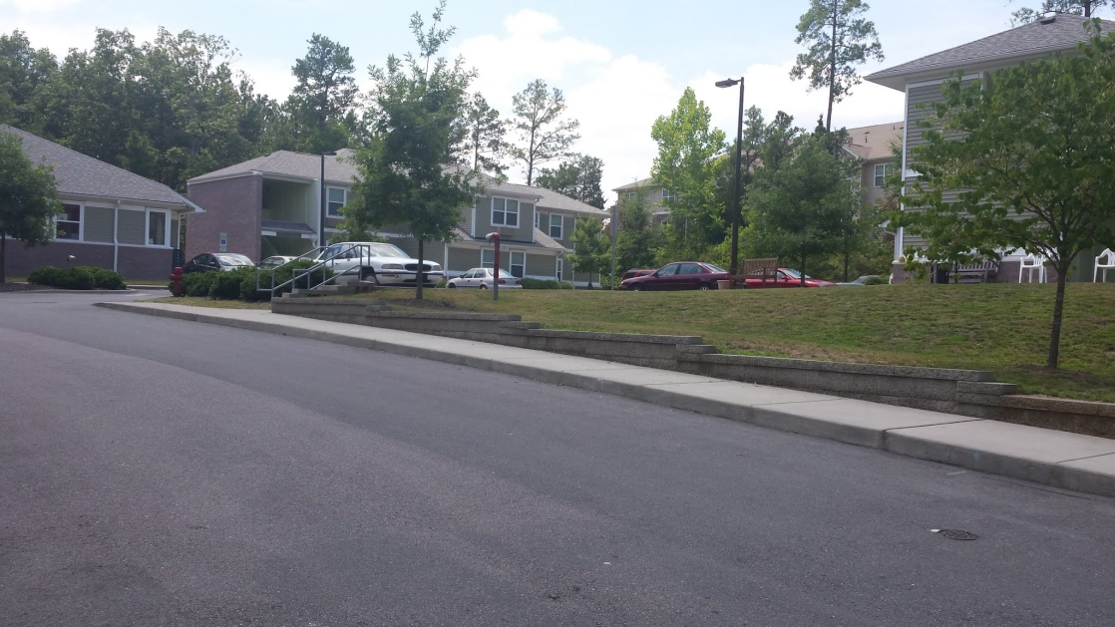
Lifelines: The journey from homelessness to housing, from story to advocacy

Slide 2
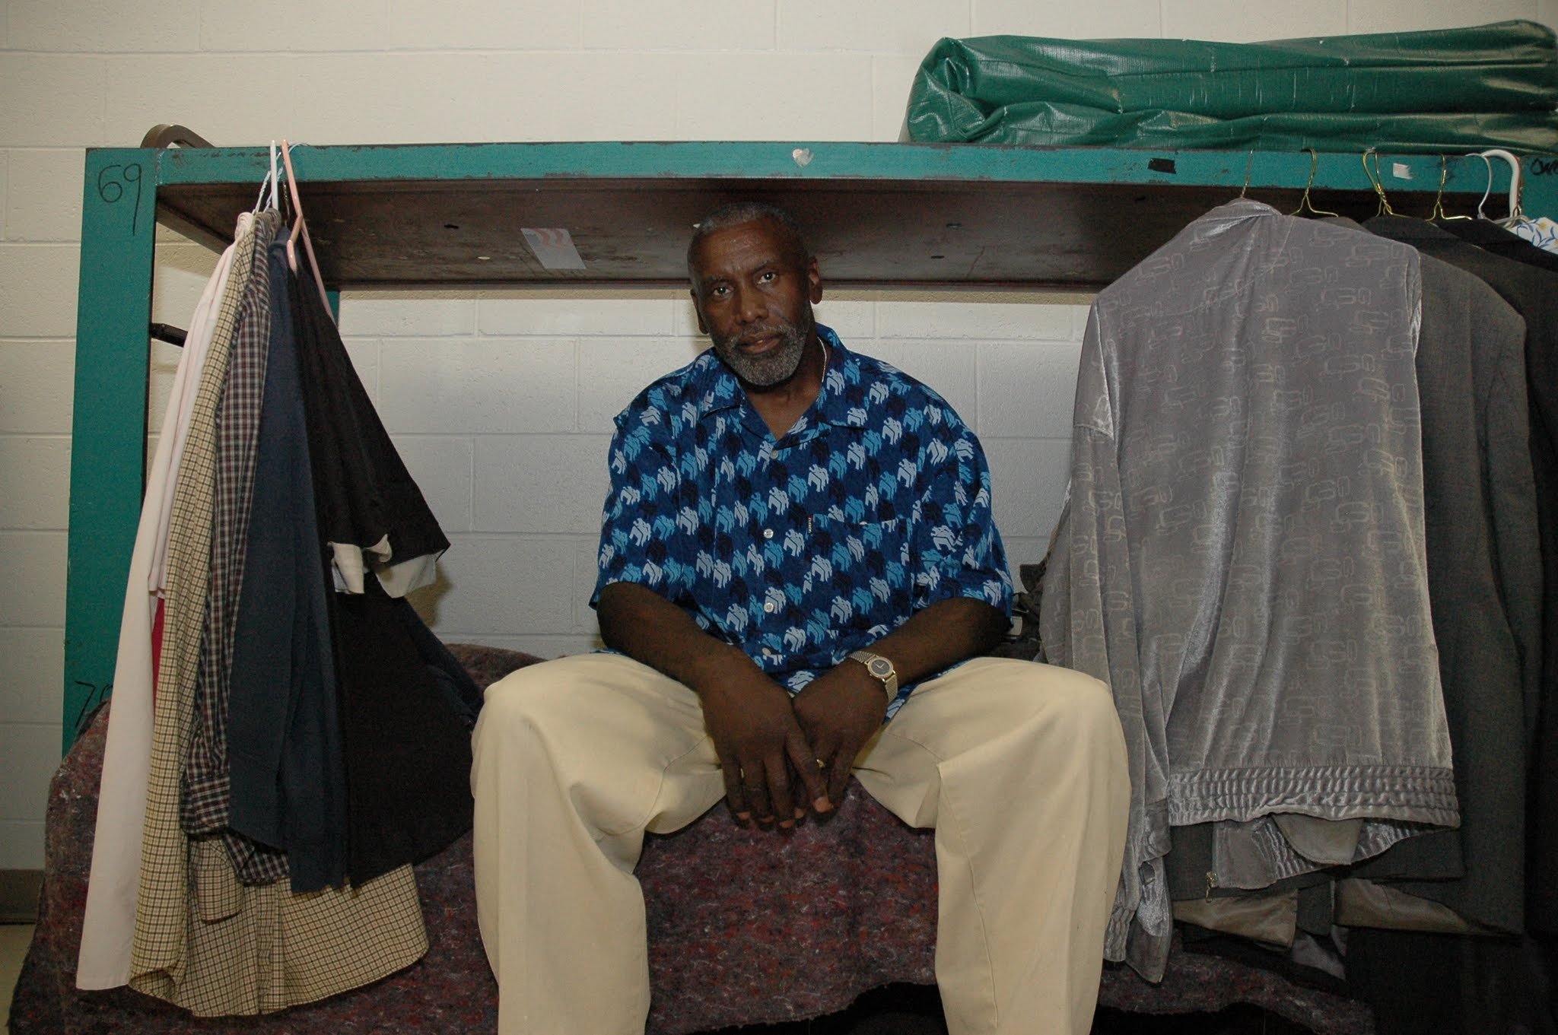
Story begins with Alphonso

Slide 3
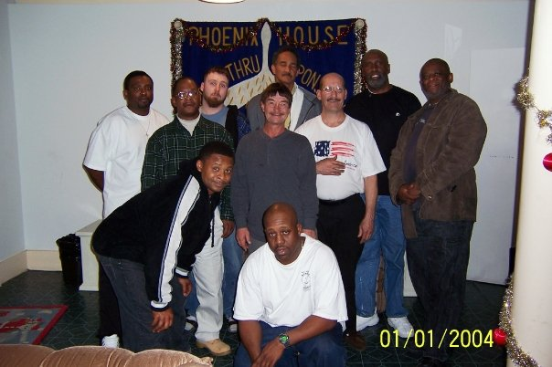
With Phoenix men

Slide 4
From homelessness to home ownership

Slide 5
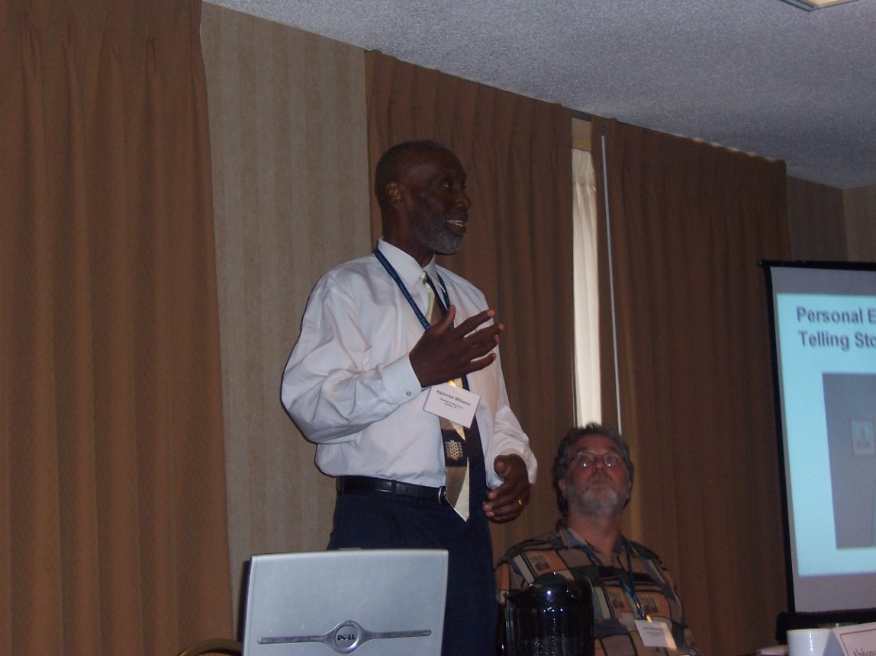
Teaching Others to Tell Their Stories

Slide 6
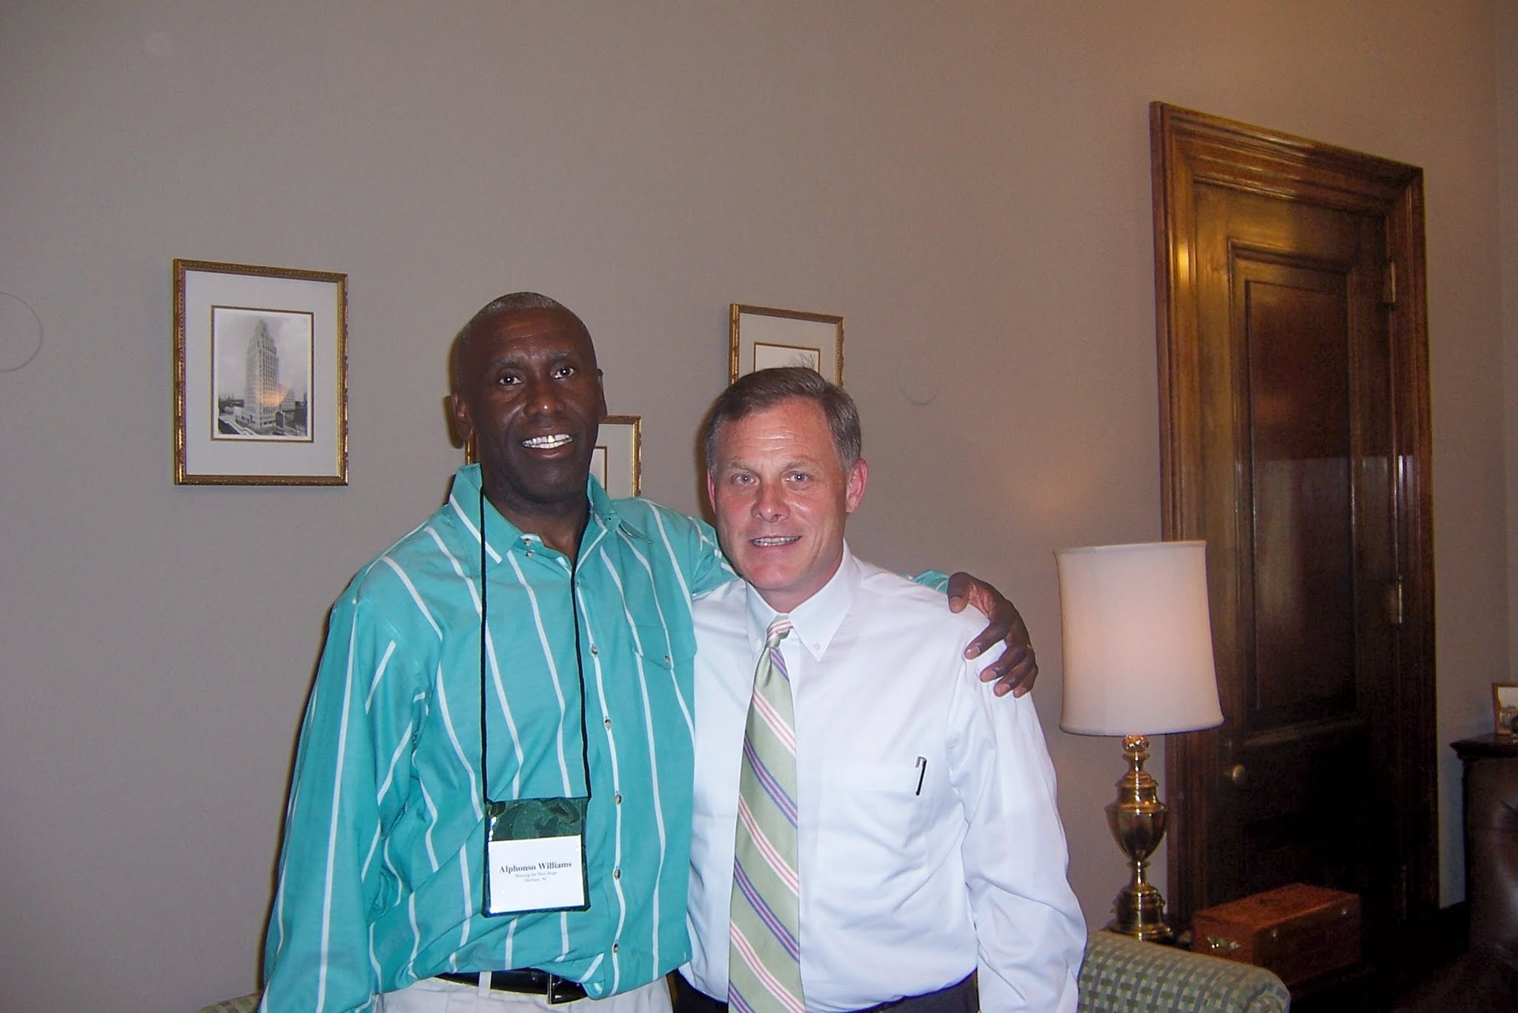
Embracing advocacy

Slide 7
Merger, acquisition, and a new direction

Slide 8
Andover Apartments

Slide 9
Andover Apartments

Slide 10
Roxboro site plan

Slide 11
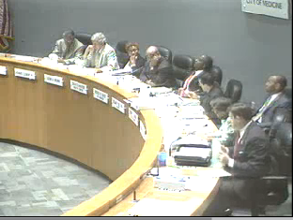
City Council votes
“City rescinds land transfers to nonprofits - Action by split council comes after neighbors protest” Headline from Durham Herald-Sun 8/21/07

Slide 12
Considering legal action
The Fair Housing Act protects people from discrimination when they are renting, buying, or securing financing for any housing. The prohibitions specifically cover discrimination because of race, color, national origin, religion, sex, disability and the presence of children.
“I think a strong argument can be made that should the city rescind an agreement made following approved policy and procedures, it would demonstrate discrimination against people with disabilities, a class of people who are protected by fair housing laws.”
Terry Allebaugh, Editorial, DHS 8/19/07

Slide 13
Williams Square Apartments: Site Plan

Slide 14
Randi, Sam, and Alfranzia,

Slide 15
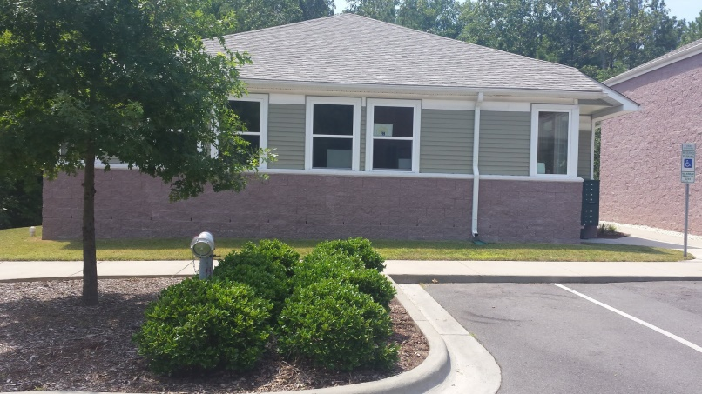
Williams Square Apartments

Slide 16
Robin at home

Slide 17
Teaching Others to Tell Their Stories

Slide 18
Launch Event – May 9, 2017

